Slide 1
Sub-millisecond Stateful Stream Querying over Fast-evolving Linked Data
郝莉民
2019-05-24

Slide 2
About Paper
Title:
Sub-millisecond Stateful Stream Querying
over Fast-evolving Linked Data
Author:
Yunhao Zhang, Rong Chen, Haibo Chen IPADS Lab
Published:
SOSP’17, October 28, 2017, Shanghai, China

Slide 3
目录 Contents
1
Background
2
Conventional Approach
3
Paper’s Approach
4
System Design
5
Implementation & Evaluation

Slide 4
目录 Contents
1
Background
2
Conventional Approach
3
Paper’s Approach
4
System Design
5
Implementation & Evaluation

Slide 5
Background

Slide 6
Background
Big Data
Real time streaming data
Vast history data
How to query or compute this big data?

Slide 7
目录 Contents
1
Background
2
Conventional Approach
3
Paper’s Approach
4
System Design
5
Implementation & Evaluation

Slide 8
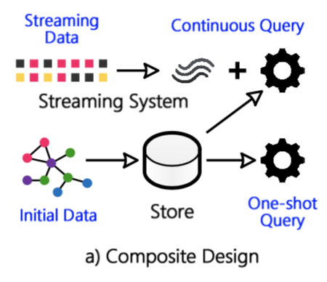
Conventional approaches
1. Stream query vs Stream computation
2. Stateless: do not consistently integrate streaming data
or do not query the persistent store
3. Composite Design

Slide 9
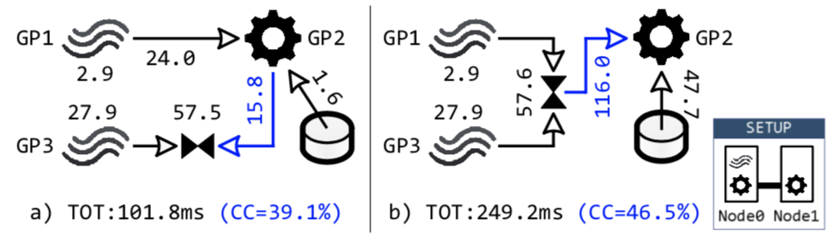
Composite Design Weakness
1. Cross-system cost:
data transformation and transmission cost
2. Sub-optimal query plan:
change query plan to reduce cross-system cost
3. Limited scalability:
A continuous query touches small streaming and stored data

Slide 10
目录 Contents
1
Background
2
Conventional Approach
3
Paper’s Approach
4
System Design
5
Implementation & Evaluation

Slide 11
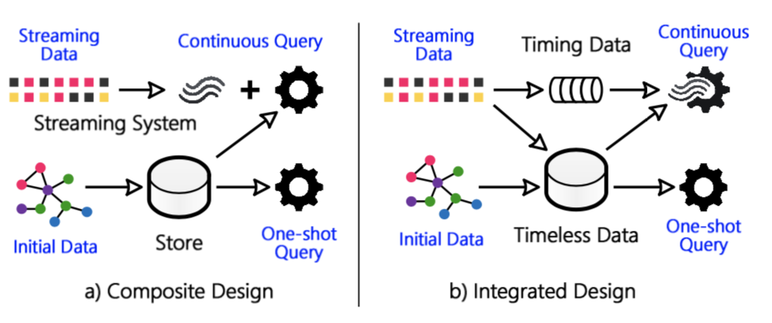
Wukong+S
Wukong+S is integrated design

Slide 12
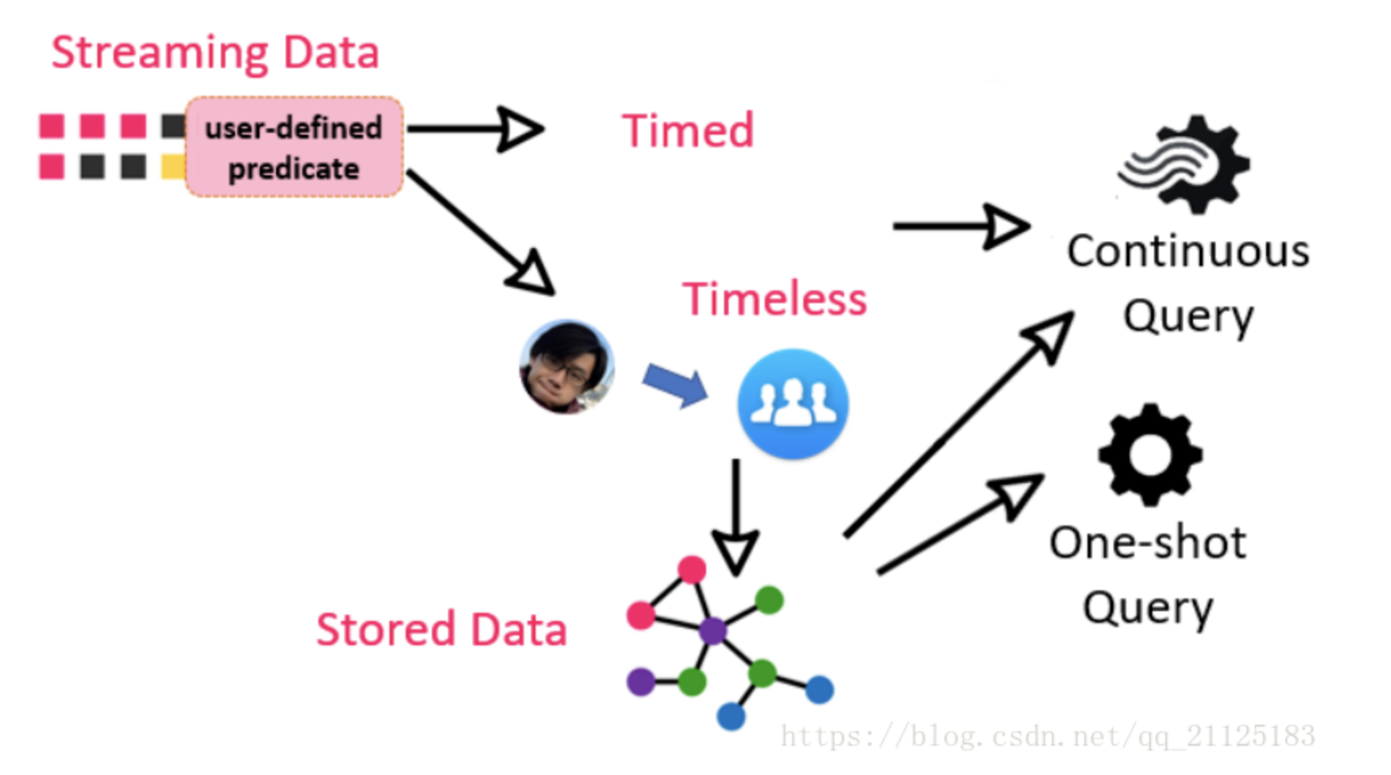
Wukong+S
Wukong+S is integrated design

Slide 13
Wukong+S approach
1. Hybrid store (timing data and timeless data)
2. efficient stream index with locality-aware partitioning
3. Consistent Query with High Memory Efficiency

Slide 14
Wukong+S
1. Stateful: Stream query is stateful.
2. Sharing among concurrent queries:
streaming data and stored data
3. Partial data: stream query usually touches small data
4. Latency-oriented: first-class citizen

Slide 15
目录 Contents
1
Background
2
Conventional Approach
3
Paper’s Approach
4
System Design
5
Implementation & Evaluation

Slide 16
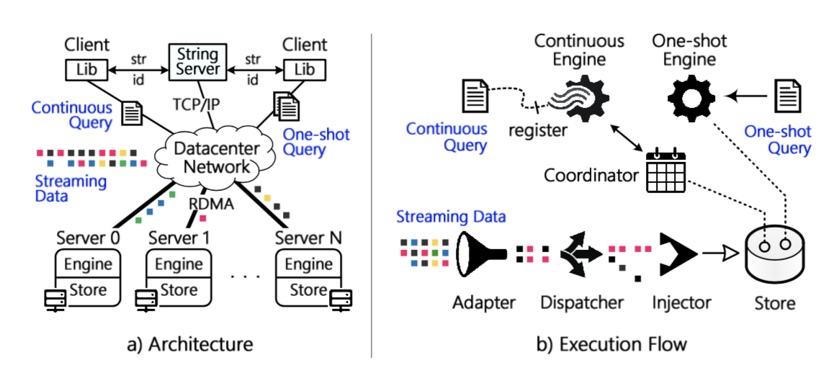
Wukong+S Architecture
Adapter: Group tuples by individual timestamps and indicate timing and timeless data.
Dispatcher: Partition and dispatch the tuples in a batch to multiple nodes.
Injector: Insert the batches received from Dispatchers into the hybrid Store.

Slide 17
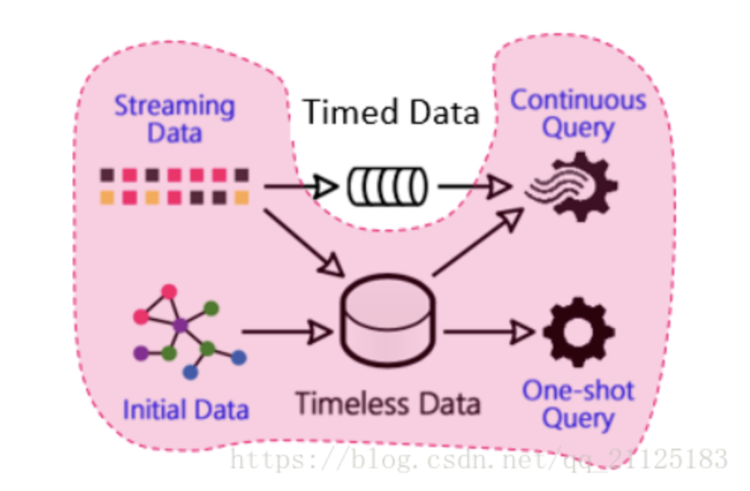
Hybrid Store (continuous persistent store)
Wukong+S inherits Wukong as the basic store
Stored data is represented as a directed graph
Key : vertex id (vid), edge id (eid), direction (d)

Slide 18
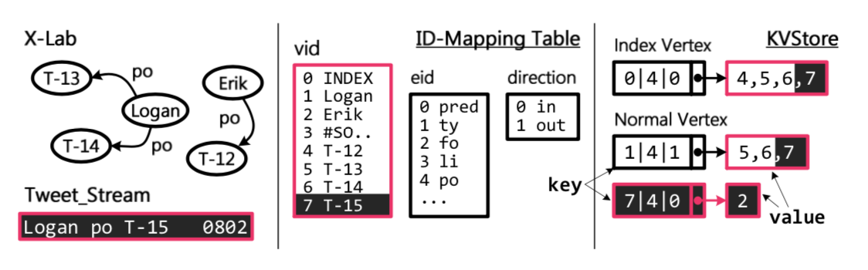
Hybrid Store (continuous persistent store)
Key : (vid, eid, d)
vertex id (vid), edge id (eid), direction (d)
id is provided by String server
drop timestamp

Slide 19
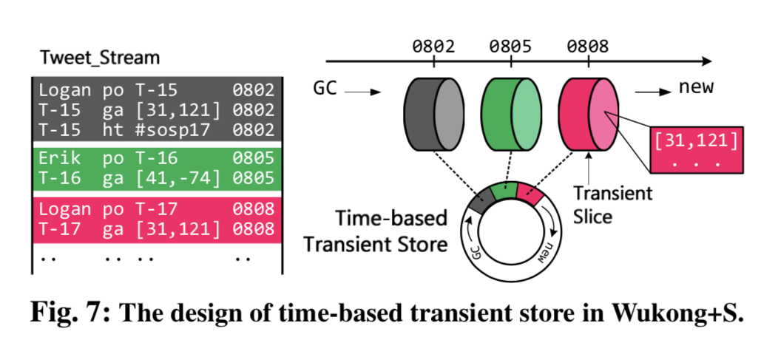
Hybrid Store (time-based transient store )
对于一部分瞬时的数据流，它能够支持快速垃圾收集(GC)，定期扫除过期的瞬时数据。

Slide 20
Hybrid Store advantages
Timeless data -> continuous persistent store
Timing data -> time-based transient store
1.在实时数据和永恒数据之间不存在互相干扰。
2.由于设计数据存储分开来存储，我们可以针对不同的操作模式进行优化。

Slide 21
Stream Index
Why Stream Index?
Continuous query needs to frequently access the latest steaming data.
After the persistent store absorbs the streaming data, such small data will be scattered over the entire persistent store.
Continuous persistent store needs to store timestamp

Slide 22
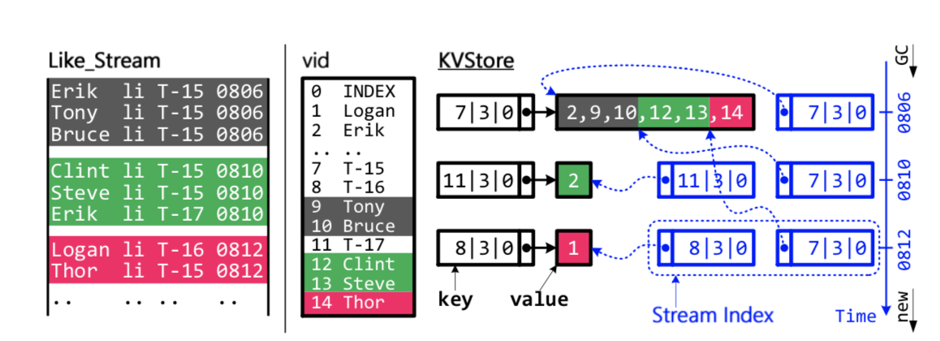
Stream Index
Example of no stream index
retrieve all persons that like the tweet T-15
from 0807 to 0811. [7|3|0]

Slide 23
Stream Index
Stream index is in a time-based order.
Stream Index creates and removes in two sides.
Each stream index consists of several entries that have the same structure to the key in the persistent store.
The difference to the key in key/value store is the pointer may locate to the middle of value.

Slide 24
Stream Index
Example of stream index
retrieve all persons that like the tweet T-15
from 0807 to 0811. [7|3|0]

Slide 25
Consistent Query with High Memory Efficiency
streaming and stored data is shared by all queries
a stream batch will be partitioned and inserted into multiple nodes, it is necessary to make streaming
data visible only when they have been inserted at all 111nodes.

Slide 26
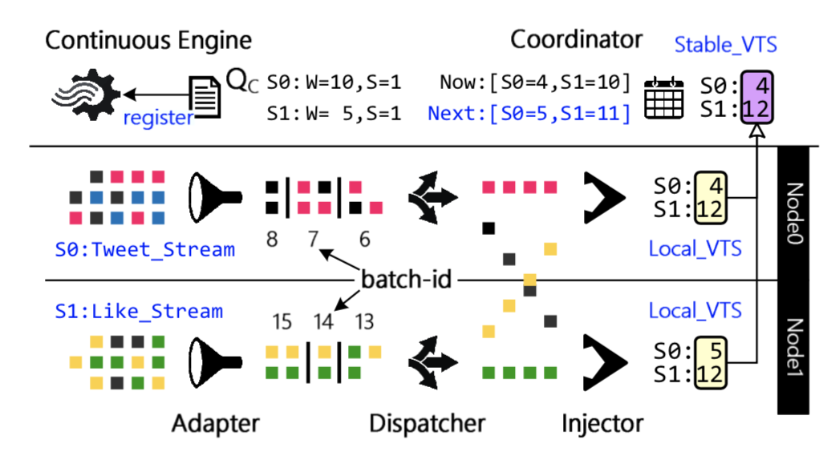
VTS
首先每个服务器都有一个本地Local_VTS,用来标识本地服务器已经插入批次的位置。然后每个服务器将自己本地的Local_VTS发送给Master协调器Coordinator，协调器Coordinator维持一个Stable_VTS服务器用来保存全局信息，这个全局信息可以用来进行Continous query操作。

Slide 27
目录 Contents
1
Background
2
Conventional Approach
3
Paper’s Approach
4
System Design
5
Implementation & Evaluation

Slide 28
Benchmarks
Two popular RDF streaming benchmarks, LSBench and City-Bench.
LSBench models a typical social network which comprises streaming data continuously generated from user activities and stored data representing properties of the social graph.
CityBench simulates a smart city application, which con- ducts continuous queries over real-time IoT data streams

Slide 29
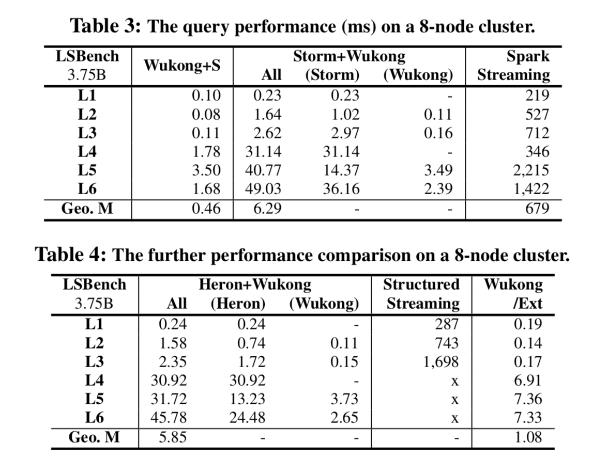
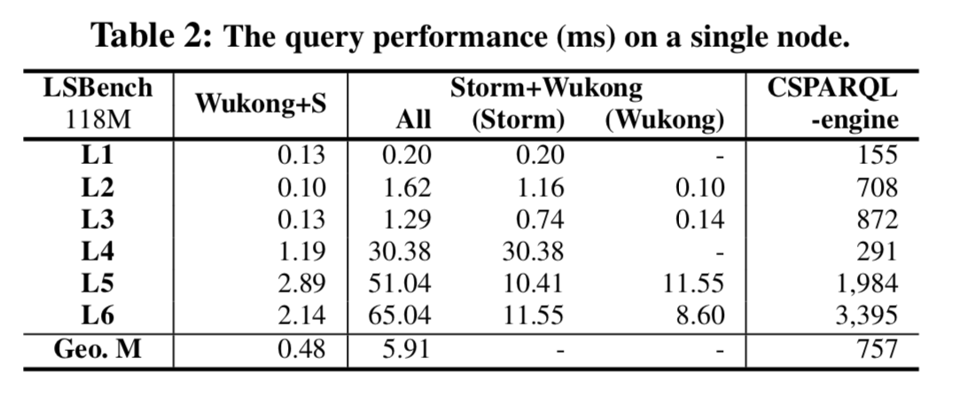
LSBench

Slide 30
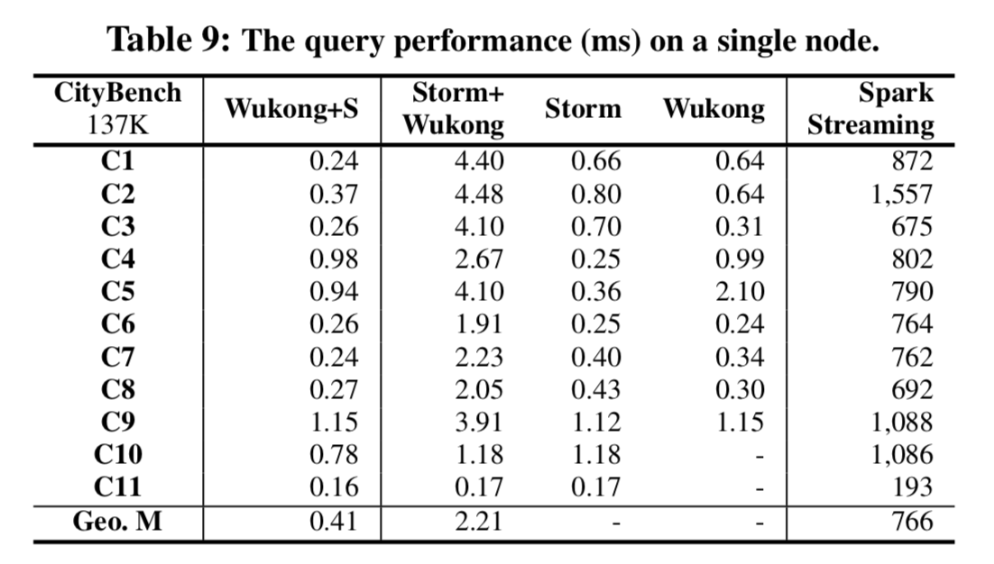
CityBench

Slide 31
Paper 2 QR Code

Slide 32
Thanks

